Slide 1



Software Development Lifecycle
Hayden & Dipesh

Slide 2

Why Agile?
Problems with waterfall:
Give me all your requirements, or it will cost you!
Impossible to know all requirements in advance
Longer analysis and design will uncover more, but there will always be emergent requirements
Emergent requirements are those that users cannot identify in advance
Intolerant of change
Long definition phase
No prioritisation, bloated feature list

Slide 3
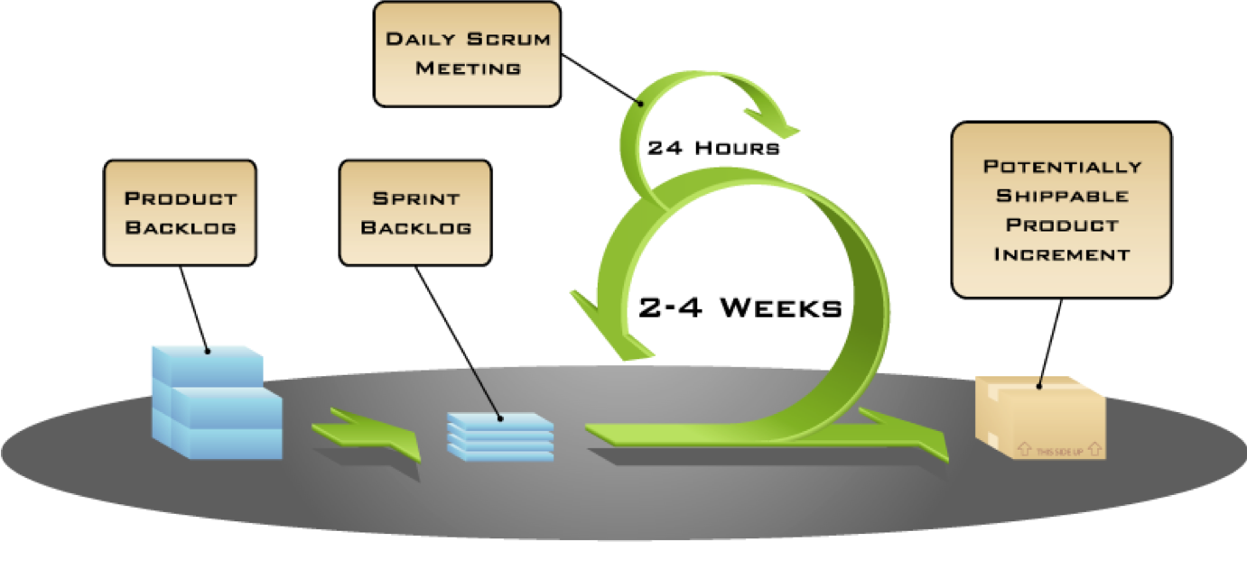
Scrum overview

Slide 4
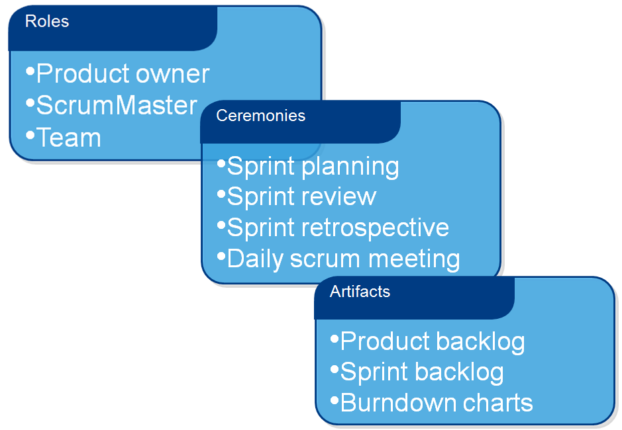

Slide 5

Notes:
https://prezi.com/h1jbkhxx8yl2/?utm_campaign=share&utm_medium=copy

Slide 6
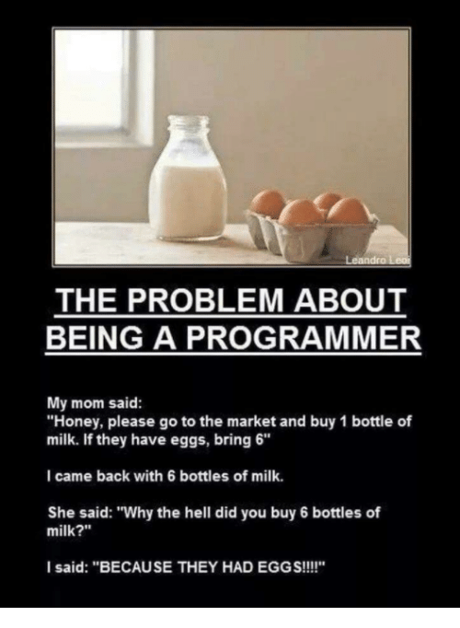
Notes:
This is how literal programming is, every word and the sequence it is written in means something different to the computer.

Slide 7
Programming Mindset
A willingness to experiment
An acceptance that you will make mistakes
An understanding that your improvement will not be linear
Knowing that perseverance pays off
Notes:
A willingness to experiment
There are times I will be trying to help people and they are just too afraid to try different things. It is important to experiment
An acceptance that you will make mistakes
It is okay to make mistakes! At Datacom people will make mistakes, as a manager though what they don’t like is when you don’t own up to it and try to cover it up, because it will only get worse.
An understanding that your improvement will not be linear
You must realise that programming is just another skill that you can master with enough practise.
Knowing that perseverance pays off
At one point, someone working on Crash Bandicoot for the PlayStation took SIX WEEKS to find the source of a bug within the game; turns out, the issue wasn’t even in the game, it was in the hardware.
For me this is the most important, I think even when you are stuck you must realise when it comes to programming if you go in with a mindset that nothing is impossible and even if you feel like you have tried researching for days and days on end. There will someone out there on some forum like stack overflow where you can post your question and get an answer back!
Reading And Understanding Code
Reading books and understanding it over time is the only way you will stop looking at lots of code as gibberish. Every line does something different, so you can break it down to one line at a time if that makes it easier.
Attention To Detail
Simple minutia mistakes are still mistakes you have to deal with
Problems Solving
This doesn’t mean you have to be an ace at maths, it is a combination of research and a whole lot of other factors.

Slide 8
Lesson 1
Introduction to Swift and Playgrounds
Constants Variables and Data Types
Operators
Control Flow
Notes:
We are following the material from the book “App Development with swift”
Used some programming before, but we will cover a lot of the basics at the start as a refresher.
Reading the theory from book, we cover it in a more practical sense

Slide 9
Course Overview
XCode, Debugging, Source Control
Classes, Collections, Loops
Display Data, Auto Layout
Optionals, Type casting
Guard statements, API structure
Scope, Segue Enums
Tab bar controller, View controller
Protocols, App lifecycle
Scroll view, Table view
System view controller, Web requests
Closures, Extensions
App deployment, Swift 5
Notes:
We are following the material from the book “App Development with swift”
Used some programming before, but we will cover a lot of the basics at the start as a refresher.
Reading the theory from book, we cover it in a more practical sense

